Slide 1
Cultural Proficiency Parent Meeting

Slide 2
North Penn’s Vision
The North Penn School District seeks to develop students who embody its universal values of achievement, kindness, collaboration, respect, responsibility, resilience, and integrity. Through an education that develops students both academically and emotionally, equitable opportunities, and a respect for human differences, members of the North Penn community will contribute meaningfully to their local and global communities.

Slide 3
Cultural Proficiency and Equity
Objective: NP administrators, teachers, and staff will continue on their journey to becoming culturally proficient educators by achieving our district goals, providing students with supports to be successful learners, and taking the initiative to enhance their professional and personal growth in this work.

Slide 4
Voices of Empowerment
The VOE is a student club that celebrates diversity and is dedicated to racial justice and lifting the BIPOC (Black, Indigenous, People of Color) voices in our school and district. We aim to empower our members to find their voices, support one another and use their power for positive change!
Led by Mrs. Bernardini and a group of student leaders across the district.

Slide 5
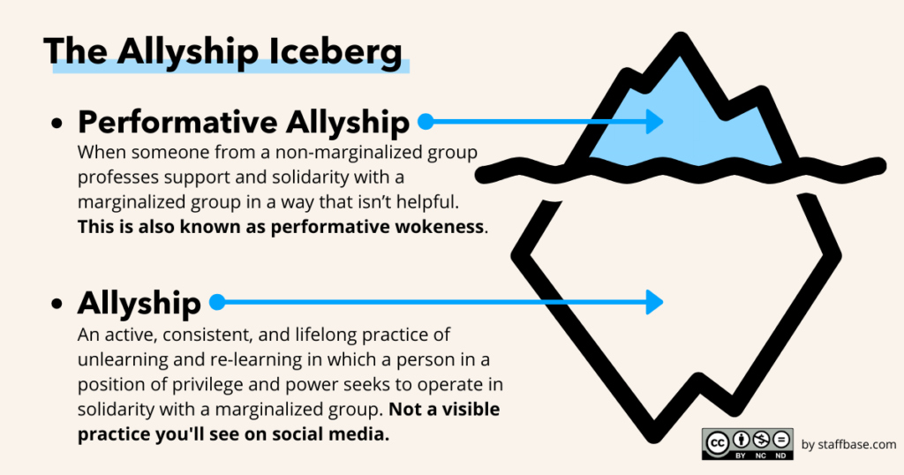
Affinity Groups and Allyship
We all have different things in common and have different needs. We are all here because collectively we believe in racial justice.
But we all enter these conversations from different paths, so it is important we allow for time apart in small groups to reflect and discuss how these issues impact our group and what we can do to help achieve the collective goals we have.

Slide 6
Voices of Empowerment
Activism/Advocacy
Education/Awareness
Service
Connection
Celebration

Slide 7
Administration
School Board
CPE Exec Committee
Dr. Barbara
Moore Williams consultant
Goals 1-4
Parents in Equity
Representation from every school.
School Level “Cadre” or Cultural Proficiency and Equity (CPE) teams
This team within each building is comprised of teachers, staff members, principal and parent rep. Can add parents to this group OR create sub-committees underneath
Each dot represents a parent member of PIE.
Home & School
Specific project committee A

Slide 8
Goal 1
To increase the knowledge, skill & practices of all staff related to cultural proficiency and cultural responsiveness which will reduce the achievement gap/opportunity gap at the North Penn School District.
Implement a framework for culturally responsive instruction.
Professional development for administrators, teachers and NPSD staff.
Embed cultural proficiency work within school goal plans and other district professional development initiatives.
Examine curriculum frameworks and make recommendations to connect cultural proficiency into content and materials.

Slide 9
2018-2021 Progress
The Cultural Proficiency & Equity Team led by Dr. Barbara Moore Williams has expanded to a HS group (with students)
Cultural Proficiency strategies and/or action steps are in embedded in each school goal plan
Administrators are engaging in book studies: We Can’t teach What We Don’t Know and Not Light But Fire.
Secretaries, bus drivers, facilities, and food services staff participated in 7 weeks of CP training during the closure
Collapsing of levels
Adoption of new novels for Secondary English
Continued co-teaching support

Slide 10
Progress Continued...
Creation of Framework for Culturally Responsive Instruction
Professional Development calendar has monthly sessions dedicated to Cultural Proficiency & Equity
Overview of District Goals and High Expectations
Racial Awareness & Anti-Racism
Disproportionality
Micro-Aggressions
Curriculum Focused Conversations
Secondary English- Cornelius Minor
Secondary SS- Matthew Kay
K-12 Librarians- Collection Analysis

Slide 11
Goal 2 Increase representation of diverse students within gifted programming and higher level courses, and reduce the number of Black, Hispanic, and Multiracial students who are disproportionately represented in special education programs and disproportionately suspended from school.
Communicate data trends to staff.
Professionally develop administrators on how to analyze disproportionality in a data.
Analyze special education testing and protocols.
Research culturally sensitive assessments for gifted and special education.
Review enrollment of student of color in Gifted courses.
Investigate possible causes.

Slide 12
2018-2021 Progress
Reviewed data district-wide and identified trends related to academic performance and discipline
MTSS teams review behavior weekly via CORE team meetings
Researched gifted screening tool and updated screening process
Middle School Science, Math, ELA and Social Studies collapsed levels to minimize disproportionality
Ongoing consultation work with Dr. Eddie Fergus with administrators and North Penn High School Leadership Team and teachers on disproportionality.
Work with Middle Schools to develop an Equity Task Force focused on creating an action plan to improve disproportionality.

Slide 13
Goal 3 Implement practices that promote a pool of diverse candidates for positions across all employee groups.
Develop promotional materials highlighting NP’s diverse community and conduct outreach efforts to recruit diverse candidates
Develop staffing patterns that support placement of at least two diverse staff in every school for increased retention
Solicit feedback from current diverse staff members on what attracted them to NP and what keeps them here
Implement a “Hire Your Own” program to attract current NP students to the education field while in HS

Slide 14
2018-2021 Progress
Updated marketing materials and district website
Reached out to and shared promotional materials with local universities
Contacted HBCUs about establishing a partnership and scheduling visits
Attended job fairs at the Delaware Valley Coalition of Equity and Excellence, MCIU Diversity Fair and universities
Developed an EDU 100 course with colleges (dual purpose) for students interested in education as part of our “Hire Your Own” initiative
Joined the Delaware Valley Coalition of Equity and Excellence (trainings for CP members at UPenn)

Slide 15
Progress continued...
Educators have been receiving Implicit bias training by The Peace Center
Reviewed staff placement to diversify all schools
Annual conversations with students in cultural clubs at the high school about considering going into education
Hired diverse staff from June-September 2019:
75% administrators (3 African American and 1 White)
12% teachers (3 Asian, 3 AA, and 43 White)
35.7% kindergarten hires (2 Asian, 3 AA, and 9 White)

Slide 16
Goal 4 Increase student, staff and family engagement in cultural proficiency efforts from a baseline to determined in the 2018-2019 school year as measured by the Hanover Climate Survey.
Implement the rubric and develop action sequences for each school.
Present to Home and School Coordinating Council to support greater involvement of diverse families.
Solicit parent and student input through a community symposium.
Increase district policies and practices, especially related to the course selection, college readiness/applications, etc.

Slide 17
2018-2021 Progress
Created a Vision for Cultural Proficiency and Racial & Ethnic Equity in North Penn
Held C.A.R.E. (Conversations about Race and Ethnicity) Diversity Symposium November 2018
Held a follow up to CARE Symposium- Parent Group presentation from Abington School district on March 7, 2019
Held second Black History Oratorical Competition- February 2020
Continued participation and partnering with International Spring Festival Committee
Formation of Parent Group around equity- November 2019 and Parent classes for ESL families- February 2020
Multi-level student groups participation (DVCEE, NAACP Mock Trial, Montgomery County Day in court, NPHS Cadre, and Student Ambassadors- CP group who meets with peers in the county)

Slide 18
Still working towards....
Community partnerships
Affinity Group Socials
Training with Home and School Committees- modules
Partnerships with other school districts- both with students and professionally
Recommending that educators be a part of career days in middle schools
Training support staff professionals on implicit bias
Black History Month Videos 2021 and Oratorical Contest 21-22
Improve elementary MTSS process
Update the Middle School and High School Child Study process to be more aligned to MTSS

Slide 19
Notes:
Montgomery Elementary

